Slide 1
Exploratory and Inverse Methods for GIS-MCDA
08/20/2025
Wildfire Resilience Initiative, Firewise Council

Slide 2
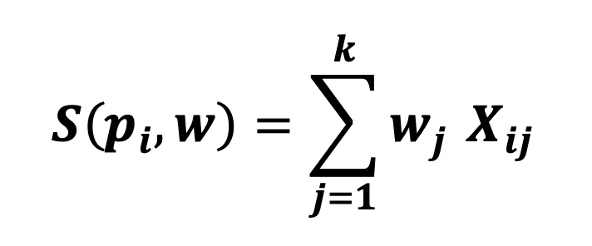
Setting
Multi-Criteria Decision Analysis (MCDA) always begins with some unit (parcels), some set of criteria (factors) and some form of weighting that must be applied to the each criterion for each parcel.
F = (f₁, f₂, ..., fₖ): Set of risk factors
(slope, vegetation, etc,)
w = (w₁, w₂, ..., wₖ): Weight vector of factors
(weights sum to 1, non-negative)
Weights are used to derive some normalized score for a given parcel:
Where:
P = {p₁, p₂, ..., pₙ}: Set of all Parcels
X[i,j]: Normalized risk factor score of parcels pᵢ for factor fⱼ
(Can be min-max, quantile, gaussian, etc.)

Slide 3
Weighting
Weighting is fundamental to MCDA. The accurate or inaccurate weighting of factors in analysis can have incredibly large impacts on the results of analysis. This step, while maybe not exciting, is JUST AS CRITICAL as any optimization or analysis method/technique.
The is a VAST history related to the processes of deriving weights and many methods exist (Malczewski, 1999; Saaty, 1973; Jankowski, XXXX?). They broadly fall into these categories:
Category | Examples | How much I like them | Key authors
Rating | Swing, point allocation, | …
Ranking | Ranksum, rank reciprocal | Sort of like.
Pairwise Comparison | AHP, ANP | I like. clever. | Saaty (1973)
Entropy/Data driven | Entropy, PCA | I like. Not always applicable.

Slide 4
Issues
If not already implied, weighting is hard. Particularly for GIS-MCDA, where spatial information must be integrated with a-spatial data, or spatial relationships must be considered.
Often in MCDA, weighting processes lack robustness, validation, and transparency (Malczewski & Rinner, 2015).
Experts often are not great at assigning weights, and the preferences they propose are often skewed/confused (SOURCE).
Most methods are not spatially explicit. The locations of factors, and importantly the location of possible outcomes are rarely considered.
We can consider methods proposed so far as ‘forward’, meaning that they rely on expert elicitation rather than observed outcomes.

Slide 5
Contribution
We are proposing and demonstrating a tool and method for decision makers to infer weights from observed preferences rather than using priori defined weights.
Through an interactive tool, a user may perform on the fly, spatially aware weight derivation to apply to MCDA.
Our method allows for validation, exploration, and may be used to either derive additive utility functions or linear weight vectors.

Slide 6
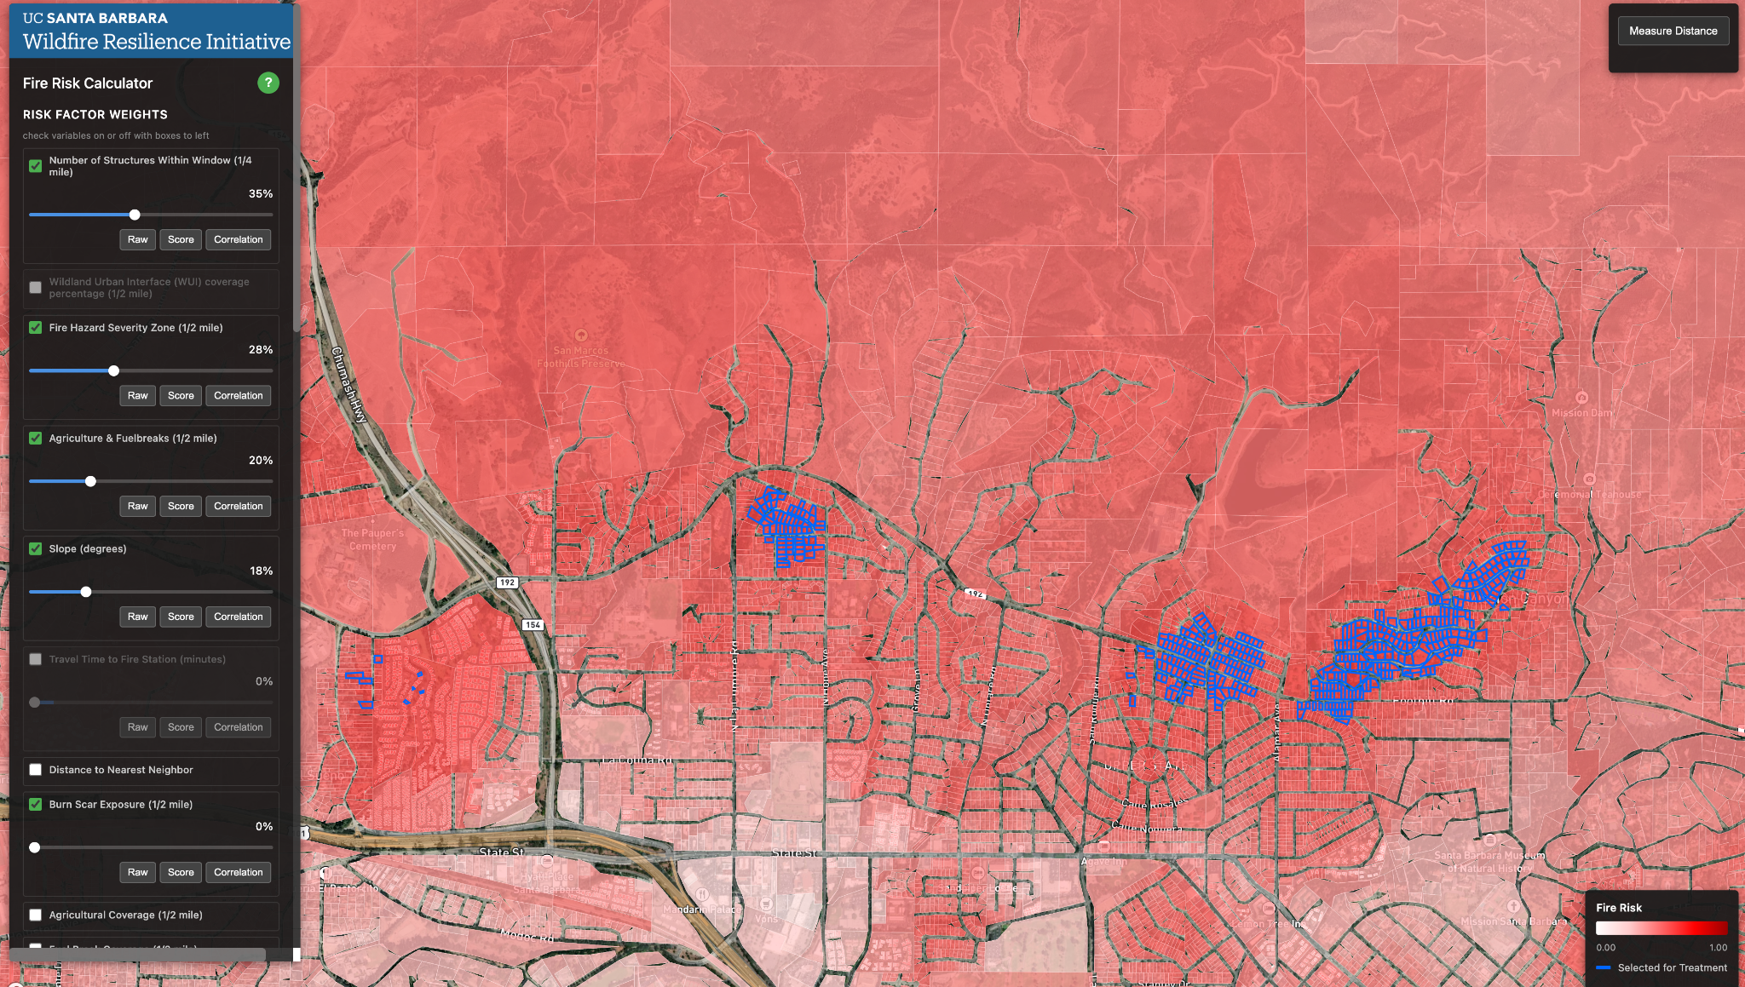
Inverse Weighting
The weighting process can be inverted. Given a set of preferred outcomes (alternatives) the weighting or utility function that would provide an outcome can be derived. The most common school of thought in this field is preference disaggregation (Siskos et al., 2016).
What weights of what factors justify expert given ‘high risk’ parcels to be ranked as the highest risk?

Slide 7
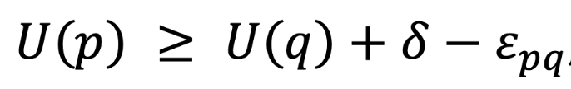
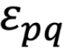
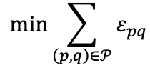
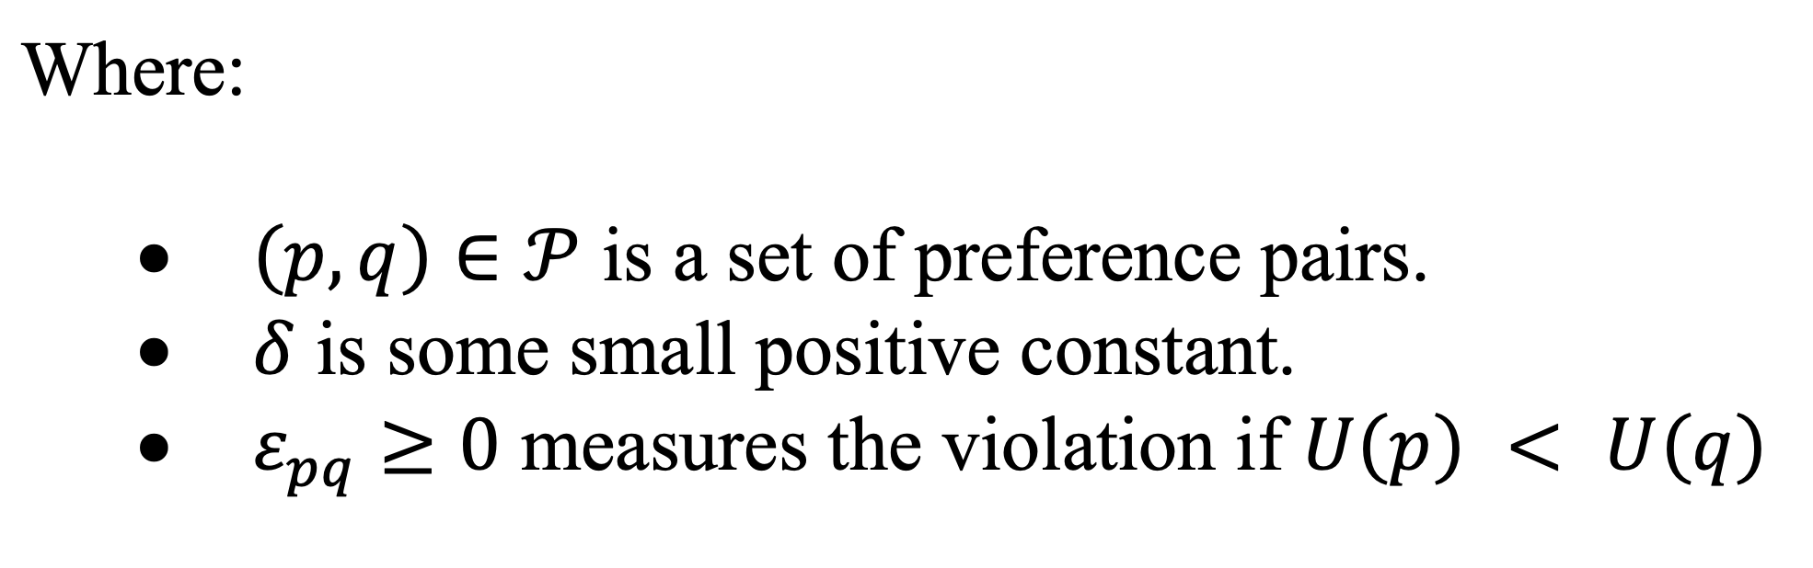
Application
Given x contiguous rook adjacent parcels (U(p))
and |P|- x total alternatives (U(q))
We create pairwise preference constraints between preferred and all other parcels.
and ALLOW violations of constrain, keeping track of slack with
Which we again minimize:

Slide 8
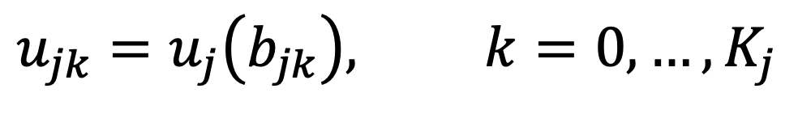
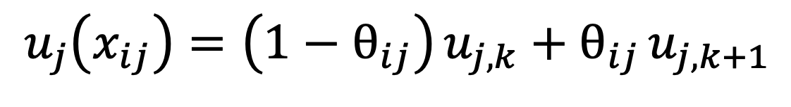
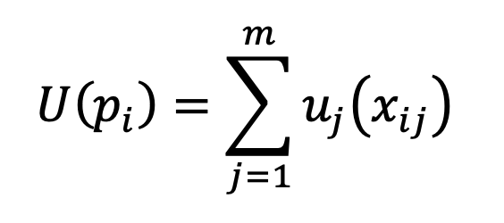
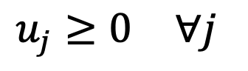
UTA-STAR Set up
There are a few methods for this. Ask about and I can tell. We shall be using UTA-STAR as it allows for partial preference information. There is a reason we want this. Let us Formulate!
We start by setting k breakpoints (b_{jk}) across a criterion’s values [0,1], where the utility (u_{j}) can be calculated at each breakpoint:
We can interpolate the utility derived at each breakpoint across the value space:
And use this utility to form a piecewise additive linear function:

Slide 9
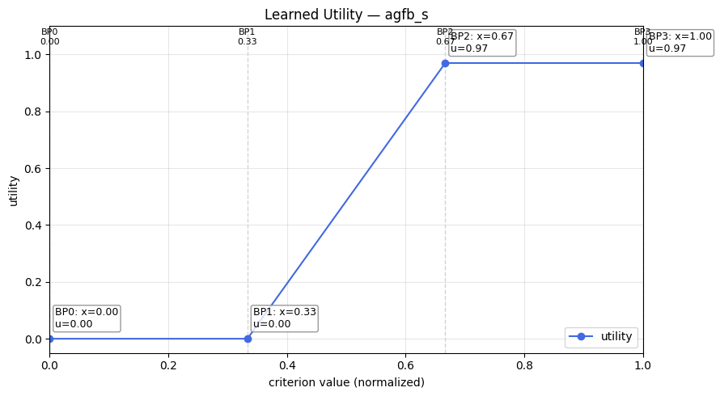
Example Utility Function

Slide 10
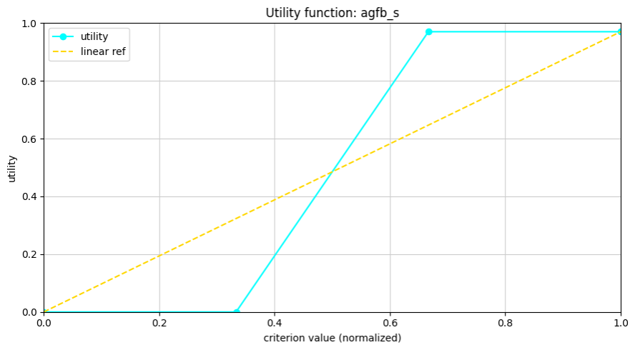
OR UTA-STAR with linear utility
Our UTA-STAR implementation may be simplified! We can set breakpoints to like at value end points [0,1] to enforce a linear utility function (same as standard weighting).
The rest of the model stays the same.

Slide 11
Applied Linear and Piecewise UTA-STAR
Piecewise UTA-STAR derives better rankings.
Test | Linear Weights (UTA-STAR) | Average Rank of Subset | Total (Error:violations)
Subset_1
Subset_2
Subset_3
Subset_4
Test | Piecewise Linear Weights (UTA-STAR) | Average Rank of Subset | Total (error:violations)
Subset_1
Subset_2
Subset_3
Subset_4

Slide 12
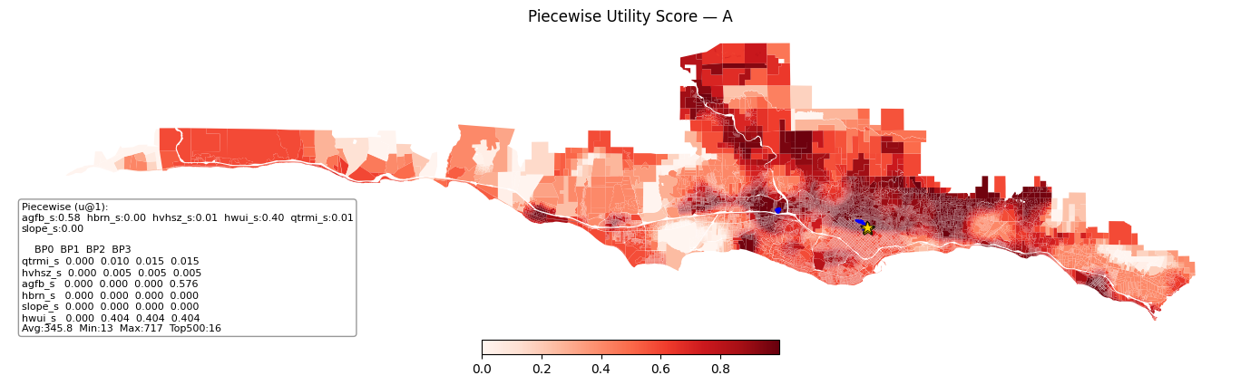
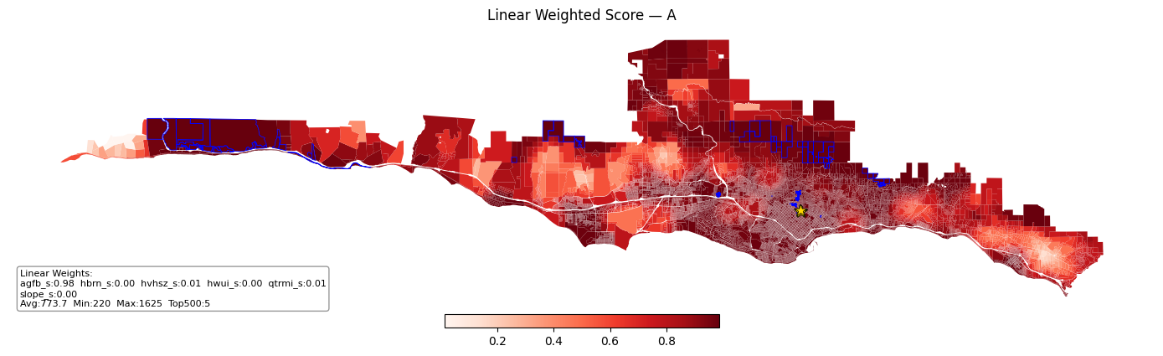
Examples

Slide 13
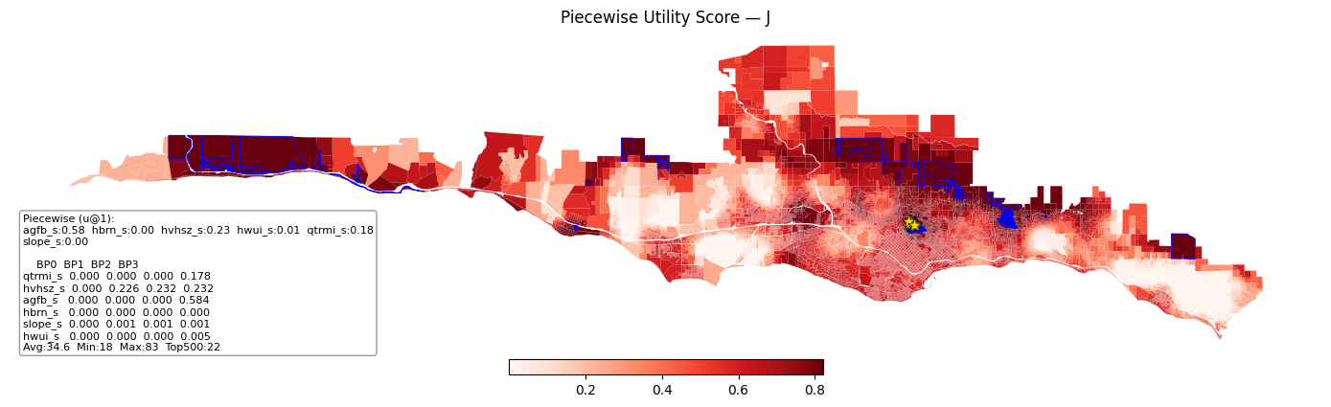
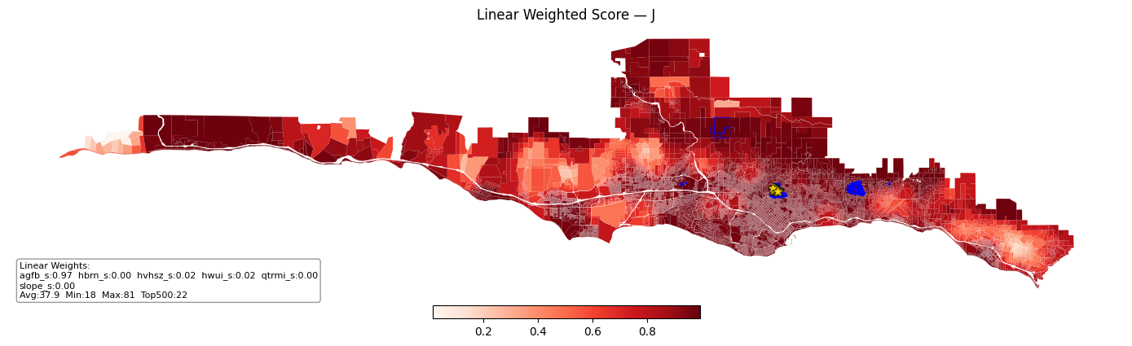
Cont

Slide 14
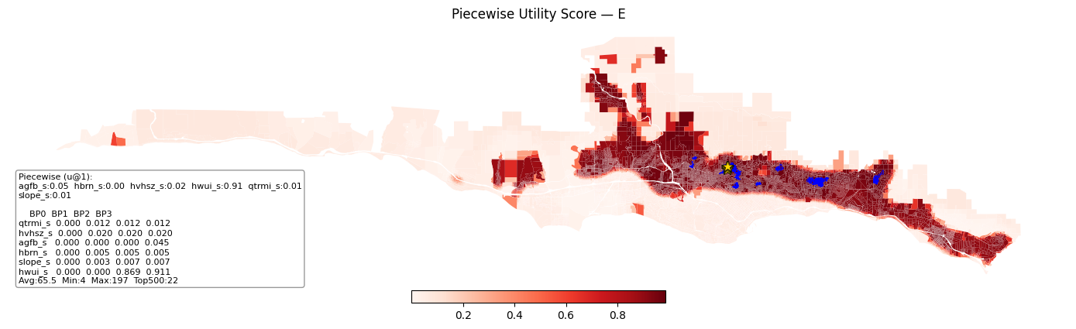
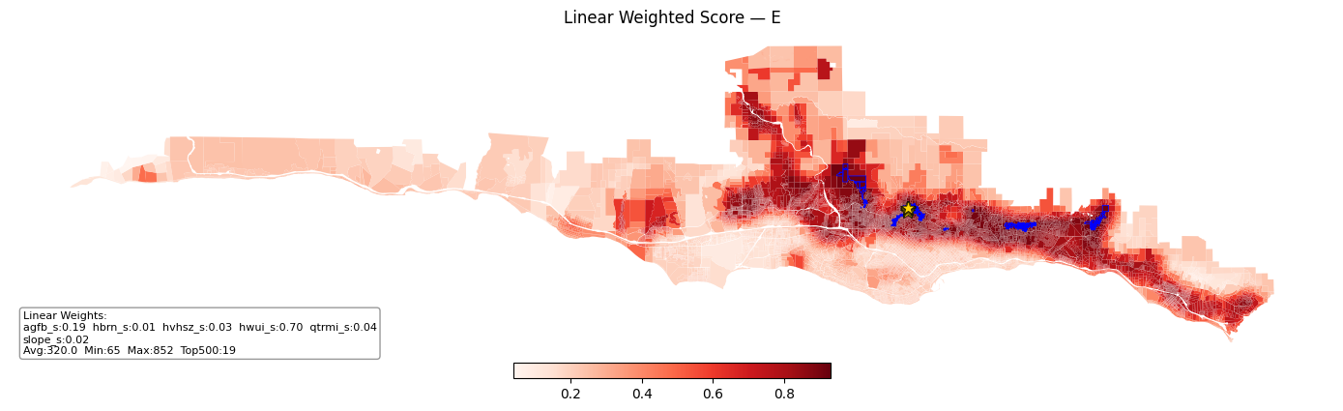
Cont.
http://localhost:5001/

Slide 15
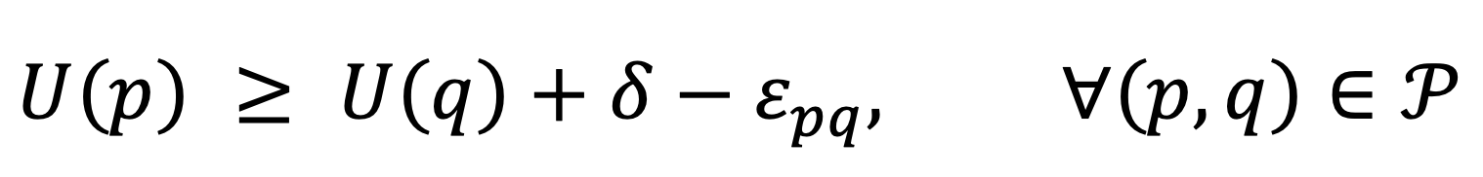
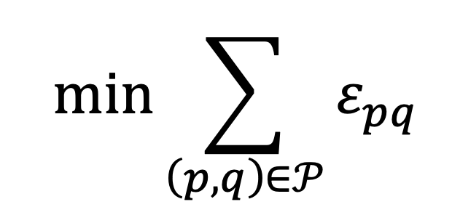
UTA-STAR Model
Now, UTA-STAR begins with a decision maker prescribing preferred alternatives (U(p)). All others are non-preferred (P(q)).
Between our preferred alternatives (U(p)) and non–preferred alternatives (P(q)), we can make a comparative pairwise constraint, and add a slack variable to allow for ‘infeasible’ solutions:
Where our objective is to minimize this total error (slack):

Slide 16
2. Interactive Map Framework for GIS MCDA
An interactive exploratory map approach to explore MCDA weight space.
All criteria are given dynamic weight sliders (0-100).
Distribution of rankings and choropleth visualizations of ranked risk are iteratively displayed with each adjustment to weights.
Users can adjust scoring normalization techniques and view distributions of criteria distributions
“Malczewski (1999b) suggests that the main objective of using maps in multiple criteria spatial decision analysis should be the consideration of geographic allocations in the process of exploring tradeoffs among the decision criteria and the search for best (compromise) solutions to the decision problem” (Jankowski, 2001).

Slide 17
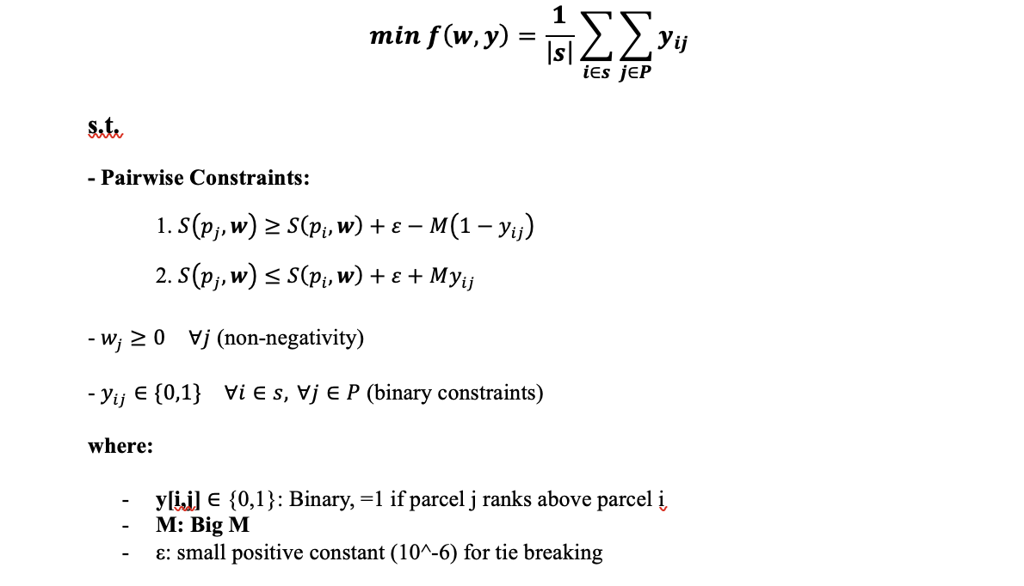
1. Rank Minimization
Application of Rank Minimization Problem to large scale GIS MCDA.
Given a high fire risk set of parcels within Santa Barbara’s Wildland Urban Interface, find weights that minimize the ranking of these parcels.
(For implementation on large dataset, we introduce possible constraint relaxation and sampling strategies)
Problem Formulation.
Demonstrate NP hardness.
Problem can be exactly solved when P <= 100.
Sampling, aggregation, or constraint restriction may be used to implement at larger scales.

Slide 18
Brief Outline and Story
GIS MCDA has a noted lack of exploratory and inverse MCDA. Weight derivation is currently centered around expert elicitation.
Inverse MCDA exists within Operations Research under forms of inverse optimization and preference disaggregation, but it has seldom been applied to GIS-MCDA, and not at all to hazard mitigation.
In this paper, we introduce inverse MCDA methods and an exploratory framework to support hazard mitigation decision making.
First, we formalize the rank minimization problem as an inverse method in a GIS-MCDA setting. We apply it to derive weights from an identified high risk location within the Wildland Urban Interface. To solve this problem, we identify and implement sampling and constraint relaxation methods for large-scale problems.
Second, we present an interactive map framework to allows DMs to dynamically adjust criteria weights and explore outcomes in ranking. We integrate our rank minimization approach to allow for spatially implicit weight derivation by experts.

Slide 19
Current MCDA and MCDM in GIS
GIS MCDA overly relies on ‘expert’ driven weighting schemes: AHP, WLC, OWA (Malczewski, 1999; Jankowski, 1995; Malczewski & Rinner, 2015).
Standard approaches can often be arbitrary, subjective, and spatially implicit. They cannot be supported by observed decisions. (Malczewski & Jankowski, 2020).
Numerous authors call for more systematic approaches to validating/deriving weights to improve sensitivity analysis and transparency. (Malczewski, 2006; Ligmann-Zielinska and Jankowski, 2008; Malczewski and Jankowski, 2020).
Inverse weighting methods do exist within MCDA, but are very seldom applied to GIS applications (Jankowski, 2001; Malczewski & Jankowski 2020).
There is a need for inverse and interactive weight derivation for applied problems with large datasets.

